Slide 1
TWO-POINT TEST CROSS
&
THREE POINT TEST CROSS

Slide 2
TWO-POINT TEST CROSS
The percentage of crossing over between two linked genes is calculated by test cross, in which an F, dihybrid is crossed with a double recessive parent (Aa Bb x aa bb).
Such a test cross is called two point test cross, because it involves crossing over at two points.
The distance between two genes can be calculated by taking the example of Maize.
When a maize plant with seeds having colour and full endosperm (CSh/CSh) with another plant having recessive alleles for shrunken colourless and seeds (csh/csh), all the F₁ hybrids produced coloured and full seeds (CSh/csh).
When F₁ female hybrids are test crossed with double recessive parent (csh/csh), four types of seeds are produced.

Slide 3
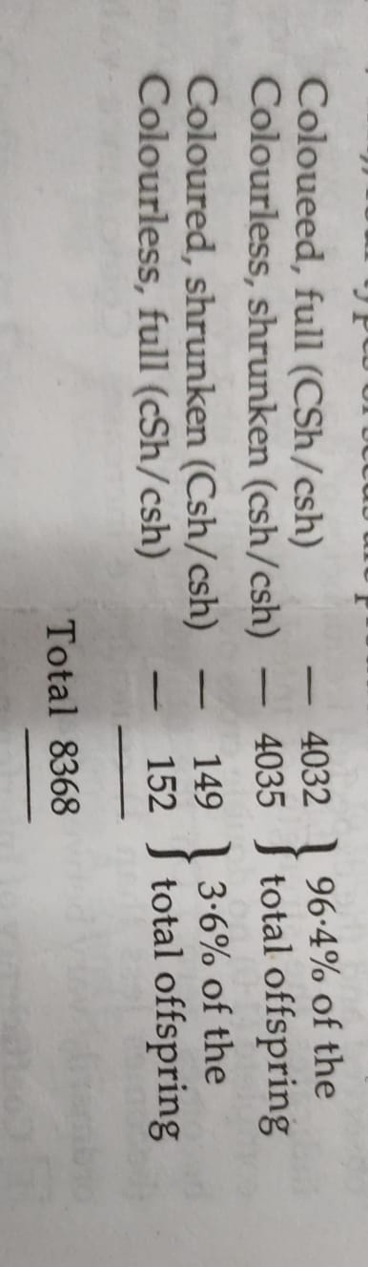

Slide 4
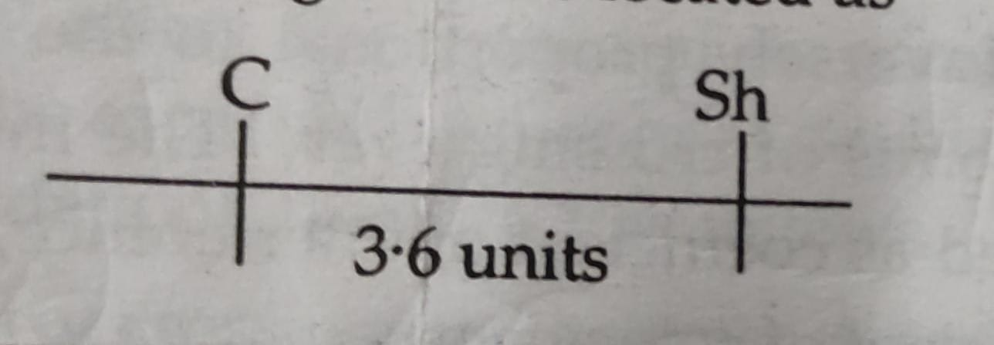
From the test cross data, it becomes clear that the genes C and Sh were located in the same chromosome and are linked together. Only 3-6% individuals were obtained due to crossing over between the genes C and Sh. Since, the percentage of crossing over indicates the relative distance between the linked genes, we can determine the distance between the genes C and Sh to be 36 centi Morgans or map units. Thus, we may draw a genetic map of that part of chromosome in which these genes are located as -

Slide 5
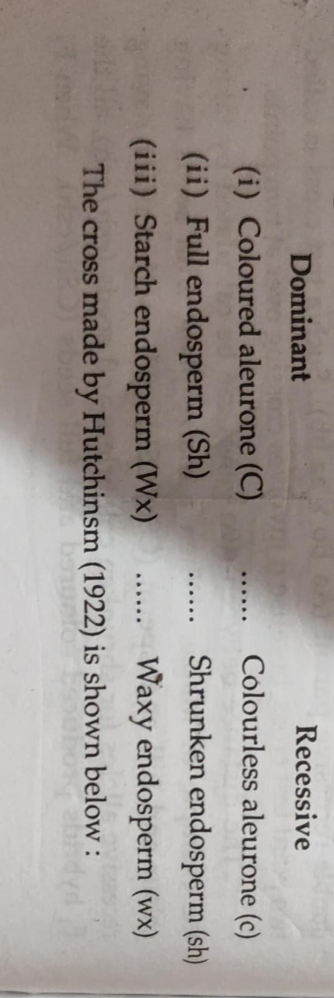
THREE POINT TEST CROSS
A three point test cross or trihybrid test cross gives us information regarding the relative distances between three linked genes. It also shows in the linear order in which these genes are present in the chromosome.The preparation of a linkage map can be explained by taking an example from maize involving three endosperm characters

Slide 6
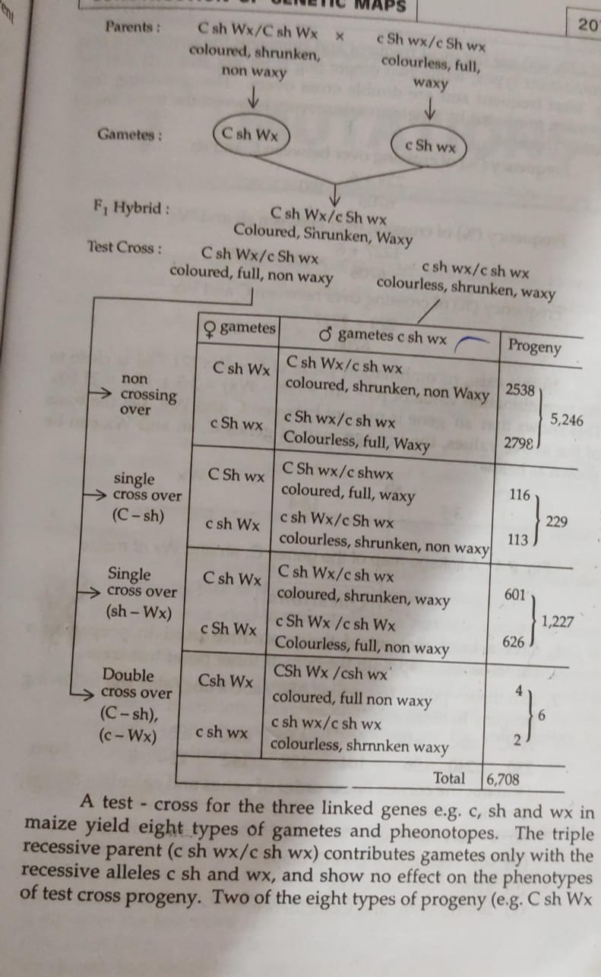

Slide 7
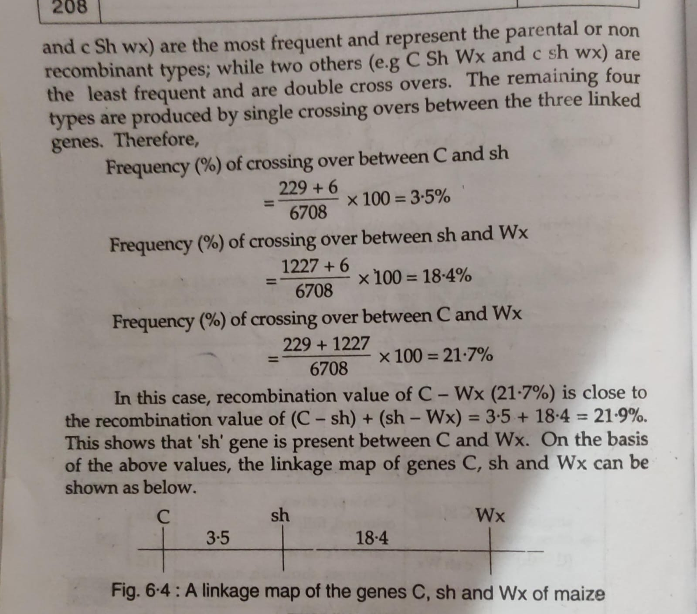

Slide 8
THANK YOU

